Slide 1


CLIENT TRAINING · REGISTERMYSITE
Own your name
online.
Why your business needs its own domain name — and how to find the right one in minutes.
yourbusiness.com
Ryan Swanson · RegisterMySite.com
Your name. Your address. Your front door online.
Notes:
Hi everyone, I'm Ryan Swanson with RegisterMySite. Thanks for taking a few minutes with me.
Here's what we're going to cover today. First, the "why": why having your own domain name, something like yourbusiness.com, makes a real difference for walk-ins, foot traffic, and bookings. Then the "how": I'll show you, step by step, how to find a great name using our free domain search tool.
No tech background needed. If you can type a text message, you can do everything I'm about to show you.

Slide 2






THE PROBLEM
Sound familiar?
The “coming soon” website
Social media only
yourbusiness.com
instagram.com/yourbusiness
Coming soon…
(and it’s been “soon” for two years)
No hours, menu, or booking
Great posts, but hard to find on Google
Looks closed — or abandoned
Hours, links & booking scattered across apps
Either way, customers who are ready to visit hit a dead end.
registermysite.com
2
Notes:
Let's start with what I see every day with local businesses.
Some of you have a website, but it's really just a landing page or a "coming soon" sign. Maybe someone set it up years ago and it never got finished. The problem is, when a customer lands there, there are no hours, no menu, no way to book. And honestly, it can make the business look closed.
Others of you don't have a website at all, but you're crushing it on Instagram, Facebook, or TikTok. That's awesome, and we're going to build on that. But your info ends up scattered. Your hours are in one place, your booking link is in another, and when someone searches Google, you're hard to find.
Either way, the customer who's ready to walk in the door hits a dead end. That's what we're going to fix.

Slide 3





WHY IT MATTERS
Your own domain is your storefront online
RENTING
OWNING
instagram.com/yourbusiness
yourbusiness.wixsite.com
yourbusiness.com
You own it
Instant credibility
Get found locally
Professional email
Social platforms can change the rules, or your reach, any time. Your domain stays yours.
84% of consumers say a business with a website is more credible than one with only a social page.
Gives your Google Business Profile and Maps listing an official website to point people to.
you@yourbusiness.com
74% would trust a branded email more than a free one.
Apex domain = the main name itself (yourbusiness.com), not a sub-address on someone else’s platform. Stats: Verisign 2015 Online Survey (U.S. consumers).
registermysite.com
3
Notes:
So why does your own domain matter so much? Think of it as your storefront online.
When your only address is instagram.com/yourbusiness, or a free site builder address, you're renting. That's space on someone else's property. They set the rules, they can change the algorithm, and your reach can drop overnight. When you own yourbusiness.com, that's the main name itself, what we call the apex domain. It's yours, and you decide where it points.
It also builds trust. In a 2015 Verisign survey of U.S. consumers, 84 percent said a business with a website is more credible than one with only a social media page.
It helps you get found. Your Google Business Profile and your Maps listing have a spot for your website, and your own domain gives Google and your customers an official place to go.
And it gets you a professional email. In that same Verisign survey, 74 percent said they'd trust a company-branded email address more than a free one. Compare info@yourbakery.com to yourbakery1987@gmail.com.
Source: Verisign 2015 Online Survey. https://blog.verisign.com/getting-online/verisign-2015-online-survey-97-percent-of-smbs-would-recommend-having-a-website-to-other-smbs/

Slide 4








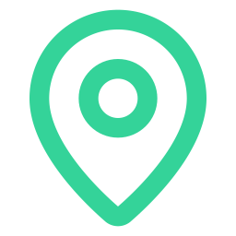

ONE LINK IN EVERY BIO
Your domain ties everything together
Instagram
Hours & directions
Facebook
One link in every bio, flyer, and receipt
One place for hours, location & booking
yourbusiness
.com
Update it once, and everything points to it
Business email
TikTok
64%
say businesses with many points of online presence are more credible than those with only a few.
Online booking
Google Business Profile
Yelp & reviews
Source: 451 Research, commissioned by Verisign, “Websites, Branded Email Remain Key to SMB Internet Services” (2020).
registermysite.com
4
Notes:
Here's the big idea. Your domain becomes the hub, and everything else becomes a spoke.
Instagram, Facebook, TikTok, your Google Business Profile, Yelp, your booking link, your email: they all point back to one address, yourbusiness.com. And that one address points out to all of them.
So instead of juggling five different links, you've got one link in every bio, on your flyers, on your receipts, on your van. When your hours change for a holiday, you update it in one place and everything points there.
And customers notice when you show up in lots of places. In a 2020 study by 451 Research, commissioned by Verisign, 64 percent of consumers said businesses with many points of online presence are more credible than those with only a few. Your domain is what ties all those points together into one brand.
Source: 451 Research for Verisign, July 2020. https://www.verisign.com/assets/Websites_BrandedEmail_Key_SMB_Internet_Services.pdf

Slide 5




FROM SEARCH TO FRONT DOOR
Local searchers are ready to walk in
76%
of people who search on their phone for something nearby visit a business within a day.
Search
“bakery near me”
Find you
Maps & your profile
28%
of those searches for something nearby result in a purchase.
Tap your site
Hours, directions, Book
Walk in
or show up to their booking
Your domain makes sure that last tap lands on a page you control, with a clear “Book” button.
Source: Think with Google, “How Mobile Search Connects Consumers to Stores” (2016).
registermysite.com
5
Notes:
Now let's talk about what really matters: people walking through your door and booking appointments.
Google published research in 2016 showing that 76 percent of people who search on their phone for something nearby visit a business within a day. And 28 percent of those nearby searches end in a purchase. These are people who are ready to act, today.
Here's how that plays out. Someone searches "bakery near me." They see you on Maps or on your Google profile. They tap through to learn more. And this is the moment that matters. If that tap lands on a "coming soon" page, or they have to dig through your Instagram grid to find your hours, you might lose them. If it lands on yourbusiness.com with your hours, a map, and a big "Book now" button, they're on their way.
I'm not saying a domain magically creates customers. What it does is make sure the people who are already looking for you have a clear path to your front door.
Source: Think with Google, 2016. https://www.thinkwithgoogle.com/_qs/documents/620/mobile-search-trends-consumers-to-stores.pdf

Slide 6




IF YOU HAVE A SITE THAT DOESN’T REALLY WORK
Turn your placeholder into a front door
Already own a domain? Great, we build on it. On a free builder address? Claim your own name.
yourbusiness.com
yourbusiness.com
Coming soon…
Maple Street Bakery
Open today 7am–3pm
Add the basics: hours, address & map, phone, and a Book or Order button.
123 Maple St · Directions
Book / Order
Link every social profile to it, and link back from the site to your socials.
BEFORE
AFTER
Goal: a customer can answer “Are you open, where are you, and how do I book?” in under 10 seconds.
registermysite.com
6
Notes:
This one's for those of you who already have a website, but it's really just a placeholder or a single landing page.
The good news: you're halfway there. If you already own your domain, we build right on top of it. If your site lives on a free builder address, like yourbusiness.wixsite.com, that's the moment to claim your own name.
Then we make it useful. It doesn't need to be fancy. It needs your hours, your address with a map, your phone number, and one clear button: Book, Order, or Call. Then we link all your social profiles to it, and link back from the site to your socials.
Here's the test I like to use: can a brand-new customer figure out "Are you open, where are you, and how do I book?" in under ten seconds? If yes, your website is doing its job.

Slide 7

IF YOU’RE SOCIAL-ONLY
You built the audience. Now give it a home.
Keep your followers. Your domain just gives them one place to land.
Put yourbusiness.com in every bio, post, and story.
maplestreetbakery
Sourdough · Custom cakes
maplestreetbakery.com
Show up for people who search Google or Maps, not just Instagram.
92%
prefer to get info from a business’s website instead of its social media page.
58%
were more likely to visit a business on Facebook if they could get there using a custom domain name.
“Link in bio” points to your own name
Source: Verisign 2015 Online Survey (U.S. consumers).
registermysite.com
7
Notes:
Now, for those of you who don't have a website but have a great social following: you've already done the hardest part. You built an audience. People like what you do.
We're not asking you to leave social media. Keep posting. Your domain just gives all those followers one reliable place to land. Your link in bio becomes yourbusiness.com, and that's where they find your hours, your location, and how to book.
It also helps you reach people who never open Instagram. Plenty of customers go straight to Google or Maps.
The Verisign 2015 survey found that 92 percent of consumers prefer to get information from a business's website instead of its social media page. And even for social-only businesses, 58 percent said they'd be more likely to visit a business on Facebook if they could get there using a custom domain name. So even pointing a domain at your existing page is a step up.
Source: Verisign 2015 Online Survey. https://blog.verisign.com/getting-online/verisign-2015-online-survey-97-percent-of-smbs-would-recommend-having-a-website-to-other-smbs/

Slide 8



CHOOSING A GREAT NAME
Four tips for a name that works
Short & easy to say
Go for .com first
Could you spell it out loud over the phone without repeating yourself?
It’s the ending most people assume. If it’s taken, .net, .org, or .co can work too.
Skip hyphens & numbers
Add your town or specialty
Names like bak3ry or maple-street-bakery are easy to mistype and hard to say.
If your exact name is taken, try combos like longbeachbakehouse or sourdoughco.
Bonus: grab matching social handles if you can, so your name is the same everywhere.
registermysite.com
8
Notes:
Before we jump into the tool, a few quick tips on picking a name.
One: keep it short and easy to say. Here's my phone test. If you had to tell someone your website over the phone, could you do it without spelling it twice?
Two: go for .com first. It's the ending most people assume. But if the .com is taken, don't panic. .net, .org, or .co can work, and the tool will show you those options.
Three: skip hyphens and numbers when you can. The search tool will sometimes suggest things like "bak3ry" or names with dashes. They might be available, but they're easy to mistype and awkward to say out loud.
Four: if your exact name is taken, add your town or your specialty. Something like longbeachbakehouse or sourdoughco.
And a bonus: if you can, grab the matching handles on your social accounts so your name is the same everywhere.

Slide 9
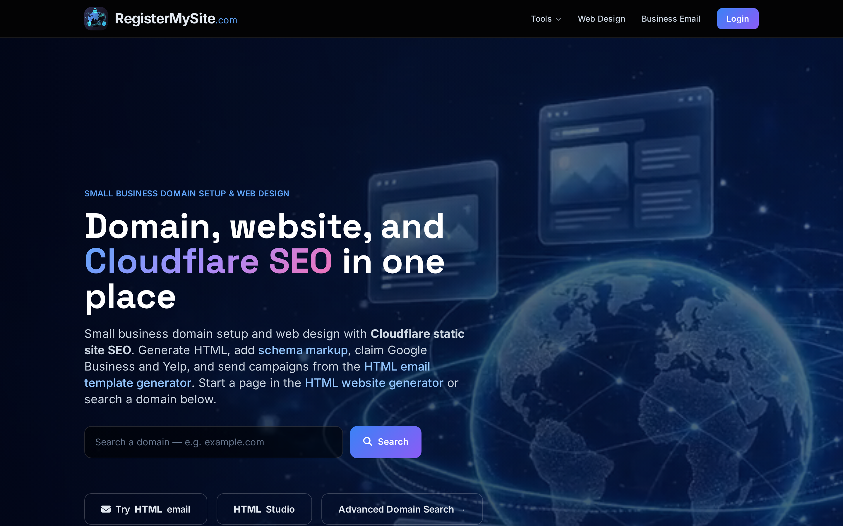


MEET REGISTERMYSITE
Your one-stop shop to get online
Domain & DNS setup
Websites & templates
@yourbusiness.com email
Google Business & Yelp listings
Start here: registermysite.com → click “Advanced Domain Search”
→
registermysite.com homepage (captured Sept 2026)
registermysite.com
9
Notes:
So let me introduce RegisterMySite. This is what we do. We help small businesses get online the right way: registering and connecting your domain, setting up a website, professional email at your own domain, and getting you listed on Google Business Profile and Yelp.
For today, we're focused on step one, which is finding your name.
When you go to registermysite.com, you'll see the homepage. There's a quick search box right there, but for the full experience, click the button I've highlighted: "Advanced Domain Search." That's the tool that checks real-time availability and pricing, and it's the one I'm going to walk you through.
(Presenter note: the homepage quick-search box uses a public DNS check and can report a registered-but-unused name as available. For accurate results, send clients to Advanced Domain Search.)

Slide 10
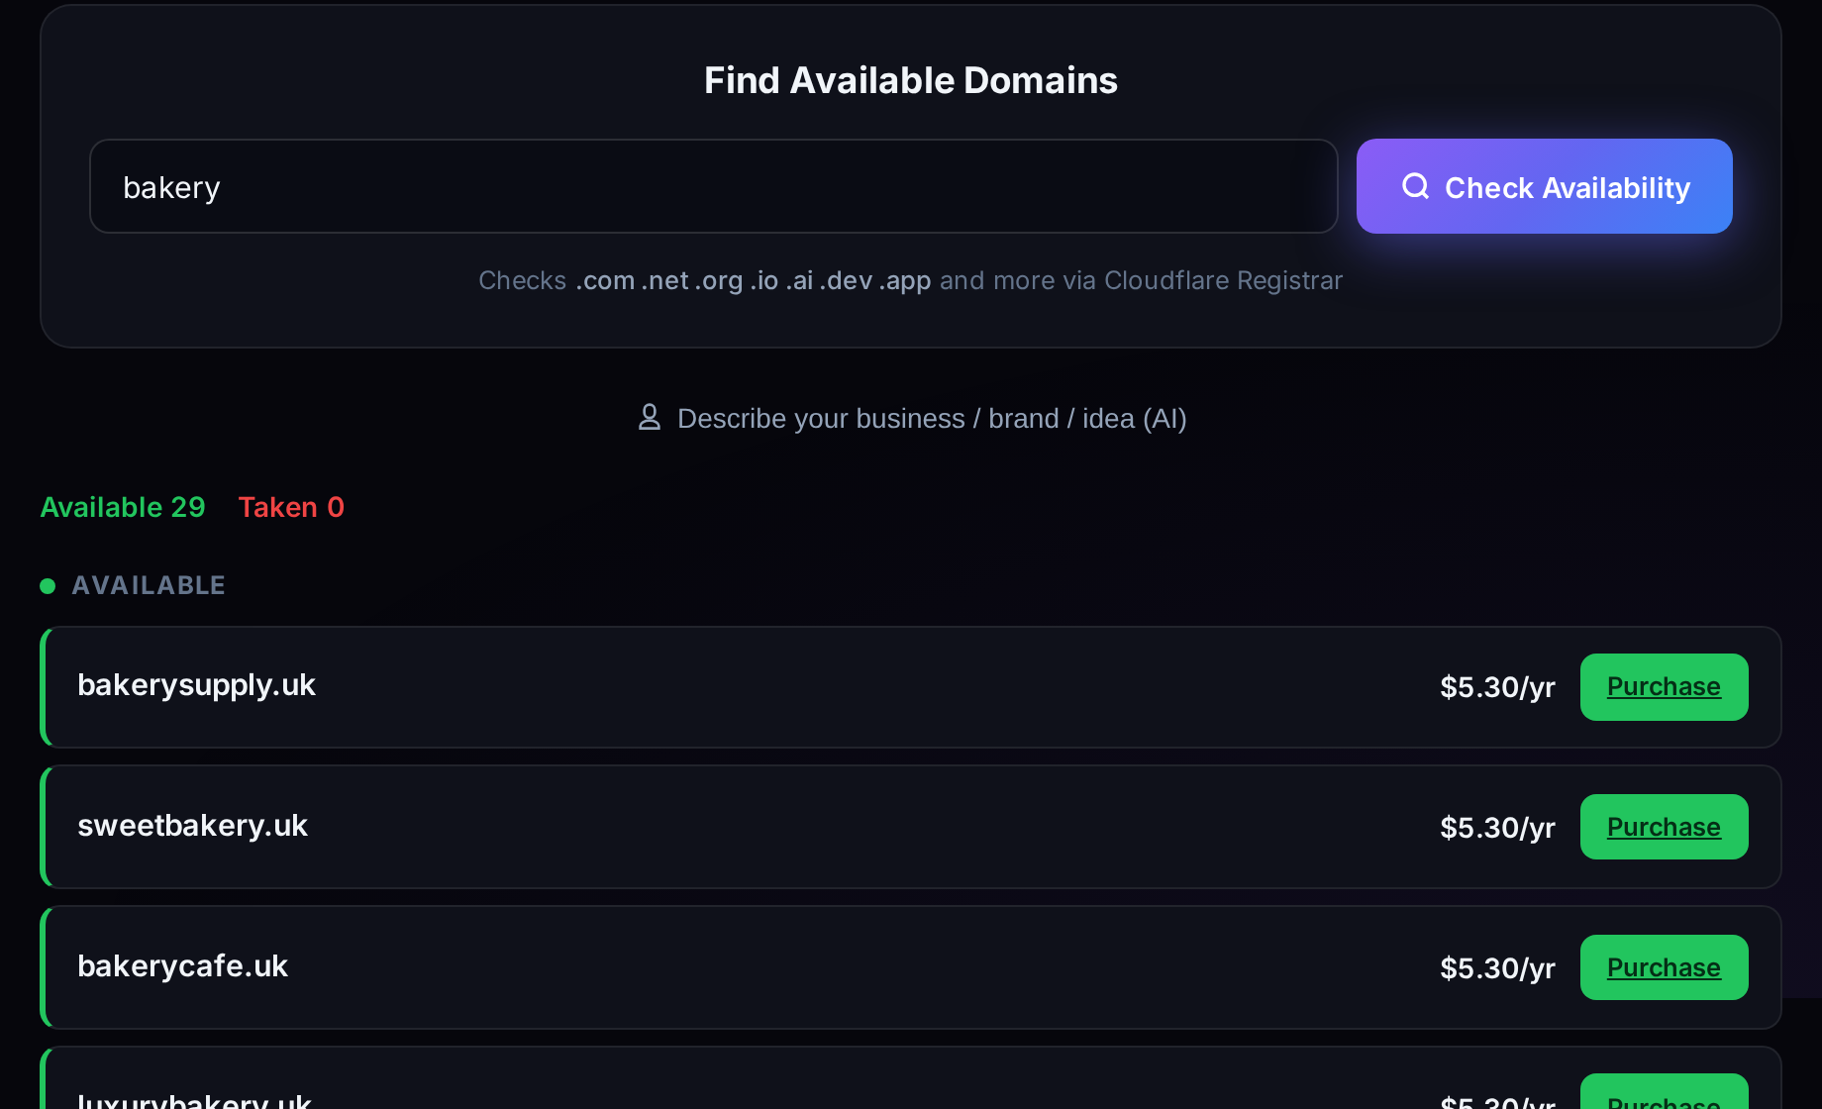
STEP 1 · KEYWORD SEARCH
Type a keyword, see what’s open
1
Go to advanced-domain-search.registermysite.com
2
3
2
Type just a keyword, like bakery
3
Click Check Availability
4
4
Scan the Available list: names, yearly price & a Purchase button
It checks .com, .net, .org, .io and more, and suggests name ideas built around your keyword.
Real search for “bakery”, Sept 24, 2026. Results & prices change as names get registered.
registermysite.com
10
Notes:
Okay, let's do this. Step one: keyword search.
Go to advanced-domain-search.registermysite.com. You'll see a big search box that says "Enter name."
Type just a keyword, one word that describes what you do. I typed "bakery." Then click the purple "Check Availability" button.
In a few seconds you get a list. Up top you'll see a count of how many are available and how many are taken. Below that, every green row is a name you can register right now, with the yearly price on the right and a green Purchase button.
What's neat is it doesn't just check one name. It checks lots of endings, like .com, .net, .org, .io, and more, and it suggests variations built around your keyword. When I ran "bakery," I got ideas like sweetbakery, bakerycafe, and bakerysupply across several endings.
Quick heads-up: this is live data, so if you try the same search, your results and prices might be a little different.

Slide 11
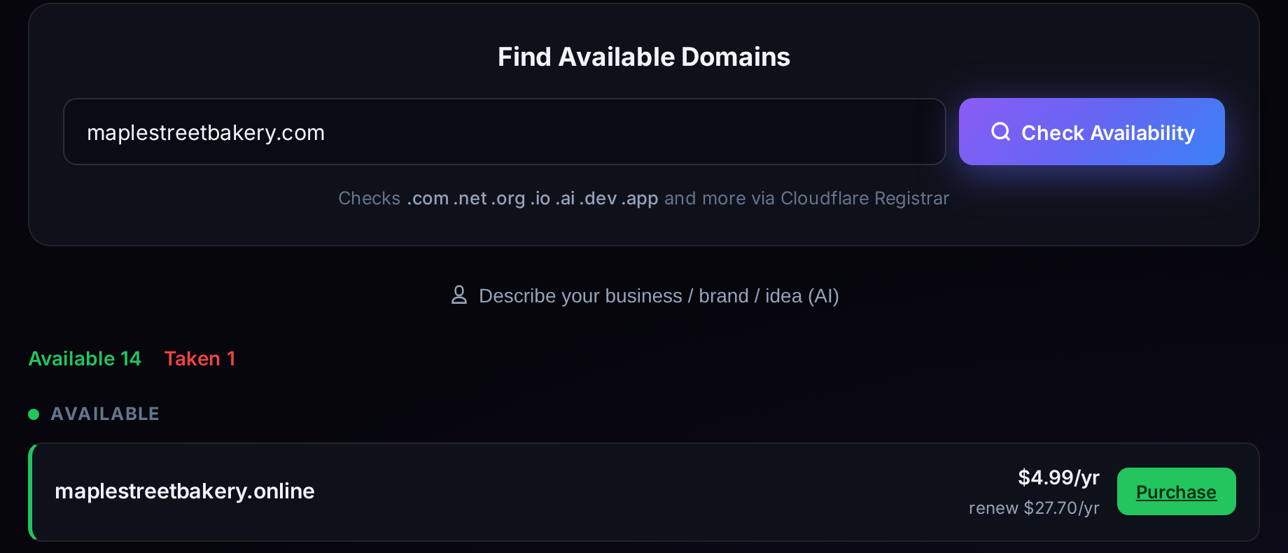
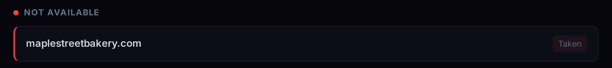
STEP 2 · EXACT DOMAIN SEARCH
Have a name in mind? Check it exactly.
1
Type the full name with the ending, like maplestreetbakery.com
1
2
See instantly if it’s Available or Taken
2
3
Browse alternatives: other endings (.net, .org, .co, .cafe) and variations
4
3
4
Compare the first-year and renewal price before you decide
↑ Further down the same results page. Made-up example business; real results, Sept 24, 2026.
registermysite.com
11
Notes:
Step two: exact domain search. Use this when you already have a name in mind.
In that same search box, type the whole thing, including the ending. I used a made-up business, Maple Street Bakery, so I typed maplestreetbakery.com and clicked Check Availability.
At the top you can see the count: 14 available, 1 taken. And if you scroll down, there's the one that's taken: maplestreetbakery.com itself. Somebody already has it. That happens a lot, and it's exactly why this tool is so handy.
Because instead of a dead end, you get options. The same name with other endings, like .org, .net, .co, and even fun ones like .cafe, plus variations like maple-street-bakery.com.
One thing I always point out: look at both prices. Some endings have a low first-year price but a higher renewal price, and the tool shows you both. That .online is $4.99 the first year but renews at $27.70, for example. Pick the one that makes sense long term.

Slide 12
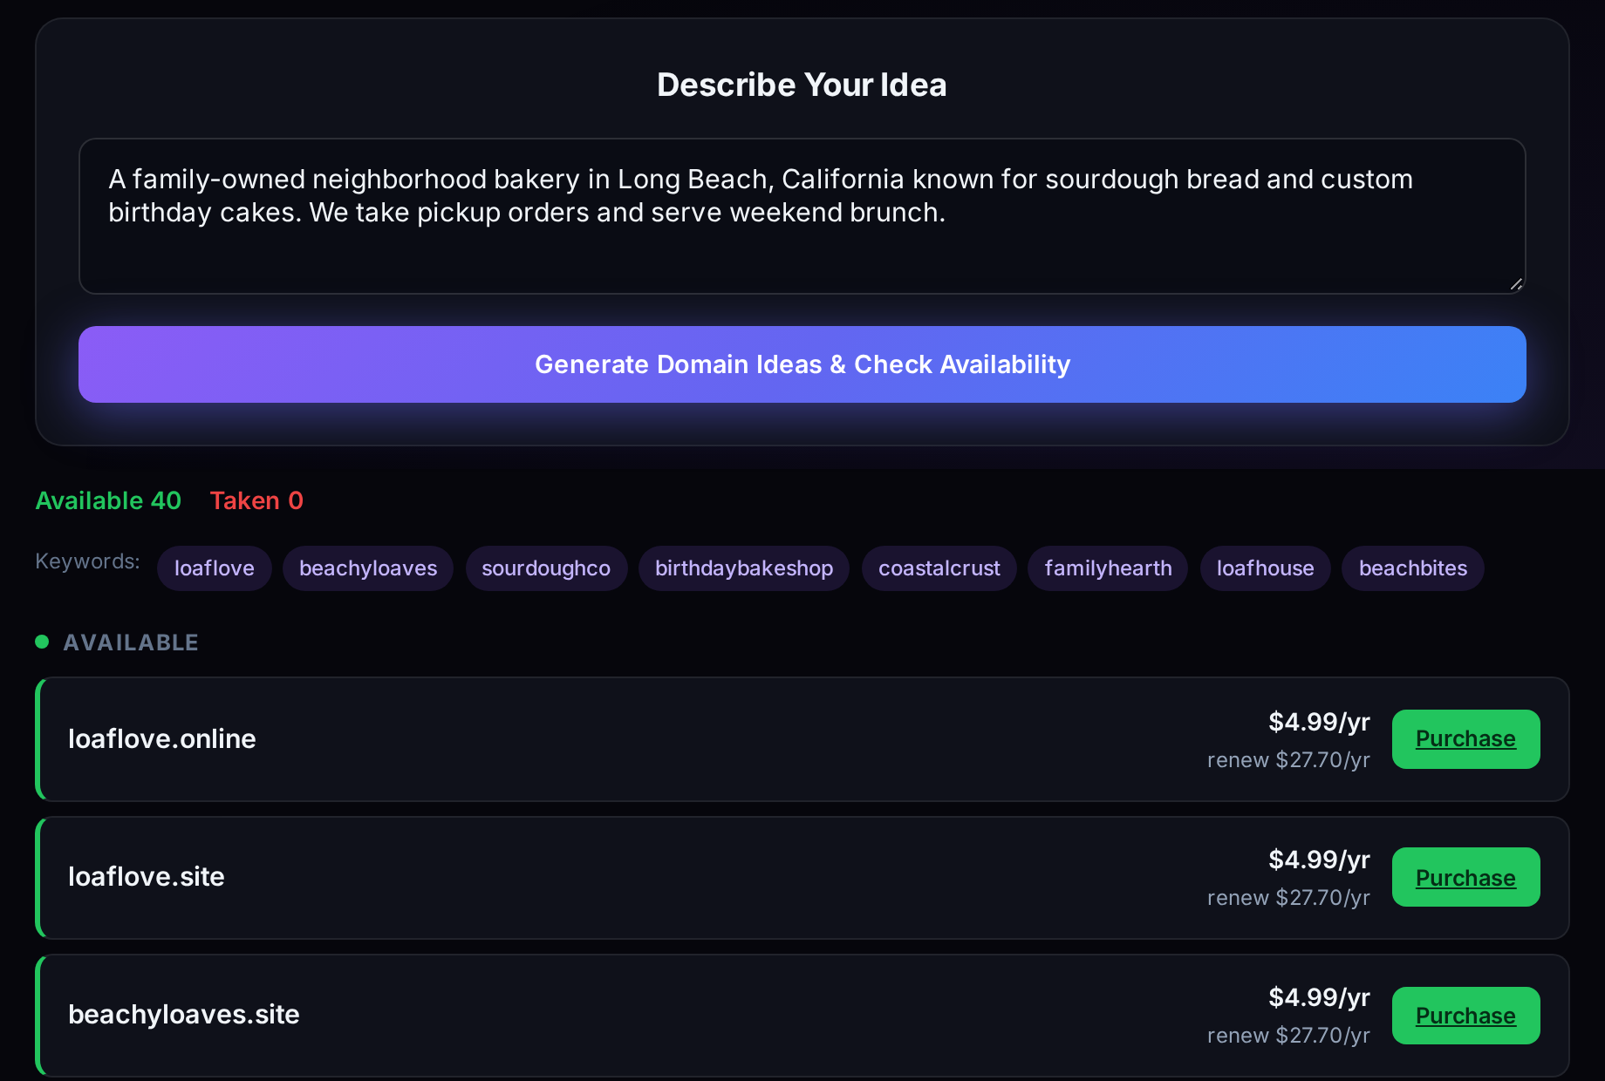
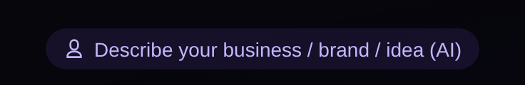
STEP 3 · AI COPILOT
Describe your business, get name ideas
1
Click “Describe your business / brand / idea (AI)”
2
2
Tell it who you are, what you sell & where
3
3
Click Generate Domain Ideas & Check Availability
4
4
Review the keyword ideas and the available names it found
Look for this button under the search box:
On the site this is the “Describe Your Idea” panel. Real run, Sept 24, 2026.
registermysite.com
12
Notes:
Step three is my favorite: the AI Copilot. This is for when you're stuck, or you just want ideas.
Right under the search box there's a little button that says "Describe your business / brand / idea (AI)." Click it, and a box opens up called "Describe Your Idea."
Now just write a sentence or two about your business, like you're telling a friend. Who you are, what you sell, and where. I wrote: "A family-owned neighborhood bakery in Long Beach, California known for sourdough bread and custom birthday cakes. We take pickup orders and serve weekend brunch."
Then click "Generate Domain Ideas & Check Availability."
The AI comes back with keyword ideas. You can see them as little tags: loaflove, beachyloaves, sourdoughco, coastalcrust. And then it automatically checks which domains are available and shows you the list with prices, just like before. When I ran it, it found 40 available names.
A tip: the more specific your description, the better the ideas. And not every idea will be a winner. Use the tips from earlier and pick the ones that are short and easy to say.

Slide 13
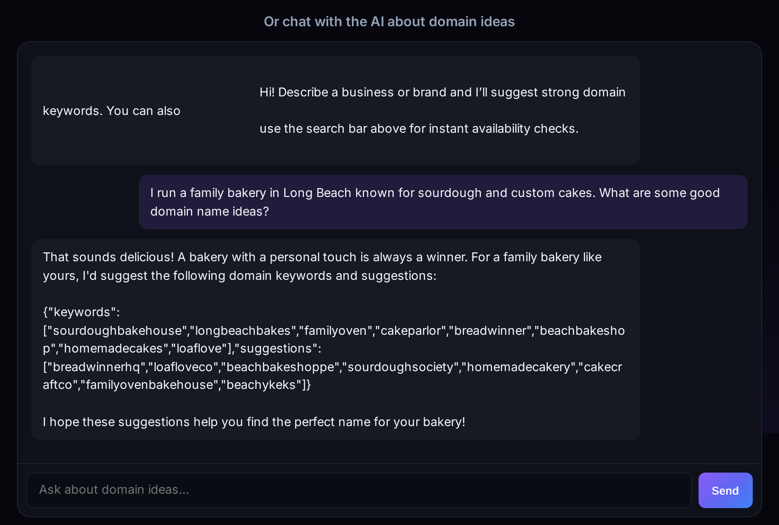


BONUS · CHAT WITH THE AI
Brainstorm names in a conversation
Scroll to “Or chat with the AI about domain ideas” and ask in plain English
Ask follow-ups: “Shorter?” “Include Long Beach?” “Something playful?”
1
2
Copy any idea you like into the search bar to check if it’s available
Chat gives ideas; the search bar confirms availability & price.
Real chat reply, Sept 24, 2026 (chat window expanded to show the full reply).
registermysite.com
13
Notes:
Here's a bonus feature. If you scroll down a bit on the same page, there's a chat box: "Or chat with the AI about domain ideas."
This is great for brainstorming. Just type a question the way you'd text a friend. I asked: "I run a family bakery in Long Beach known for sourdough and custom cakes. What are some good domain name ideas?" And it came back with ideas like loafloveco, beachbakeshoppe, and familyovenbakehouse.
You can keep the conversation going: ask for shorter names, names with your town in them, or something more playful.
One important thing: the chat gives you ideas, but it doesn't check availability. When you see one you like, copy it into the search bar at the top and click Check Availability.
(Presenter note: on Sept 24, 2026 the chat replies sometimes included raw code-style text, curly braces and quotes, after the friendly answer. If a client sees that, tell them to just ignore it; the ideas are in there.)

Slide 14

GOT YOUR NAME? HERE’S WHAT’S NEXT
Make your domain the hub
1
2
3
4
Connect it
Update every bio
Google Business Profile
Use pro email
Point it to a simple site with hours, location & a Book button. We can set this up for you.
Instagram, Facebook, TikTok, Yelp, your email signature, flyers, and receipts.
Add your website, hours & address. Complete, accurate info helps you show up locally.
Send bookings, quotes & receipts from your own address, like hi@yourshop.com.
Google Business Profile Help, “Tips to improve your local ranking on Google”: businesses with complete and accurate info are more likely to show up in local results.
registermysite.com
14
Notes:
So you've found your name. Now what? Four things.
One: connect it. Point your domain to a simple website with your hours, location, and a Book or Order button. This is exactly what we do at RegisterMySite, so we can set it up with you.
Two: update every bio. Instagram, Facebook, TikTok, Yelp, your email signature, your flyers, your receipts. Everywhere your business shows up, it should say yourbusiness.com.
Three: your Google Business Profile. Add your website, your hours, and your address. Google's own help page says businesses with complete and accurate info are more likely to show up in local search results, and that's where so many walk-ins start.
Four: start using a professional email, like you@yourbusiness.com, for bookings, quotes, and receipts. It's a small change that makes you look established.
Source: Google Business Profile Help, "Tips to improve your local ranking on Google." https://support.google.com/business/answer/7091

Slide 15

RECAP
What we covered today
WHY
HOW
Own your name instead of renting space on social platforms
Keyword search: ideas across many endings
Look credible and get found on Google & Maps
Exact search: check a name & see alternatives
One link that leads to walk-ins & bookings
AI Copilot: describe your business, get ideas
registermysite.com
15
Notes:
Let's recap.
The why: when you own your domain, you own your name instead of renting space on someone else's platform. It makes you look more credible, it helps you get found on Google and Maps, and it gives you one link that sends people to your door or to your booking page.
The how: at advanced-domain-search.registermysite.com you've got three ways to find a name. Keyword search, where you type one word and see ideas across lots of endings. Exact search, where you type the full name and see if it's available, plus alternatives if it's not. And the AI Copilot, where you describe your business and let it come up with ideas for you.

Slide 16


YOUR NEXT STEP
Let’s claim your name.
registermysite.com
Search free: advanced-domain-search.registermysite.com
(562) 751-4597
info@registermysite.com
In person across LA & Orange County
registermysite.com
16
Notes:
That's it! Your next step is simple: let's claim your name.
Head to registermysite.com, or go straight to the free search at advanced-domain-search.registermysite.com, and try a few searches tonight. Type your business name, try a keyword, or let the AI give you ideas.
And you don't have to do any of it alone. Once you've found a name you like, reach out. You can call or text us at (562) 751-4597 or email info@registermysite.com. We work with businesses across LA and Orange County in person, and remotely everywhere else. We'll help you register it, connect it, and turn it into the front door for your business.
Thanks so much for your time. What questions do you have?

